Slide 1


CS 5/7320 Artificial Intelligence Search with Uncertainty AIMA Chapters 4.3-4.5
Slides by Michael Hahsler with figures from the AIMA textbook
This work is licensed under a Creative Commons Attribution-ShareAlike 4.0 International License.

Slide 2
Types of uncertainty we consider for now*
Nondeterministic Actions: Outcome of an action in a state is uncertain.
No observations: Sensorless problem
Partially observable environments: The agent does not know in what state it is.
Exploration: Unknown environments and Online search
* we will quantify uncertainty with probabilities later.

Slide 3
Consequence of Uncertainty
Remember: The solution for the known maze was a plan consisting of a fixed sequence of actions from start to goal.
With uncertainty: Solution is typically not a precomputed sequence, but a conditional plan (also called strategy or policy) that depends on percepts.

Slide 4

Nondeterministic Actions

Slide 5
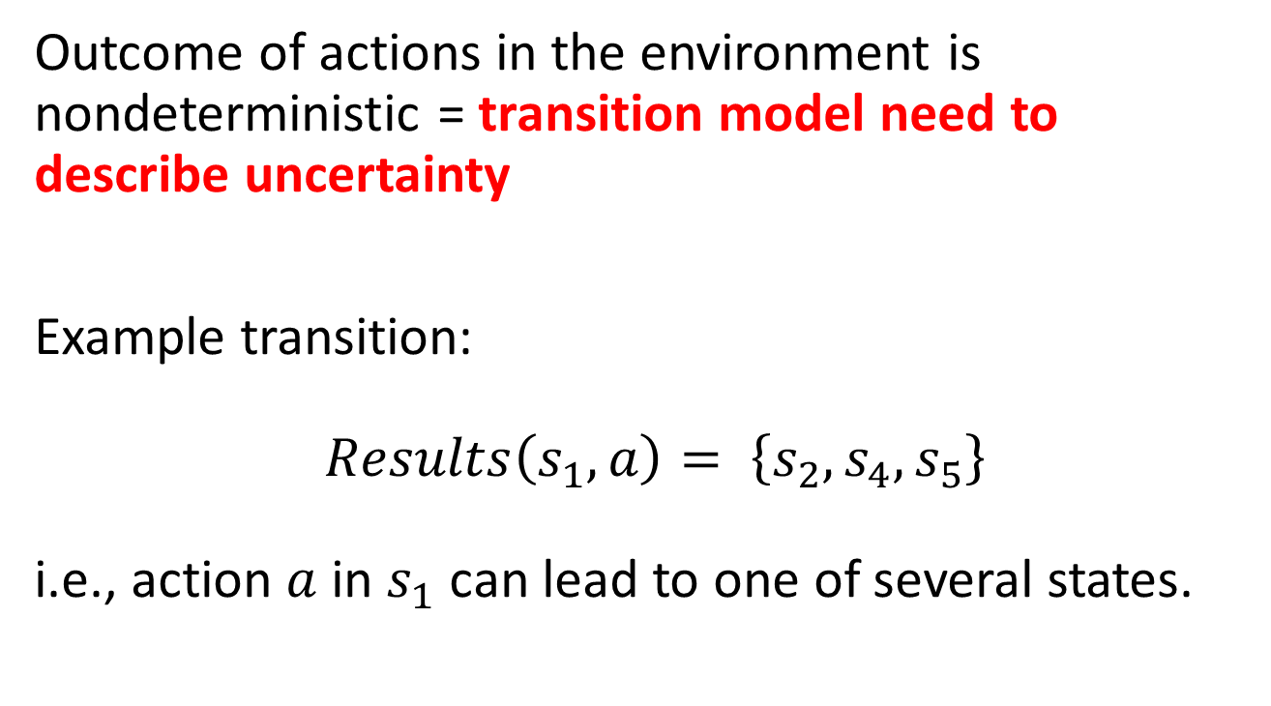
Nondeterministic Actions
Outcome of actions in the environment is nondeterministic = transition model need to describe uncertainty
Example transition: $Results\left(s_{1},a\right)= \left\{s_{2},s_{4},s_{5}\right\}$ i.e., action $a$ in $s_{1}$ can lead to one of several states.

Slide 6
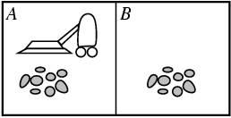
Example: Erratic Vacuum World
Regular fully-observable vacuum world, but the action ‘suck’ is more powerful and nondeterministic:
On a dirty square: cleans the square and sometimes cleans dirt on adjacent squares as well.
On a clean square: sometimes deposits some dirt on the square.

Slide 7
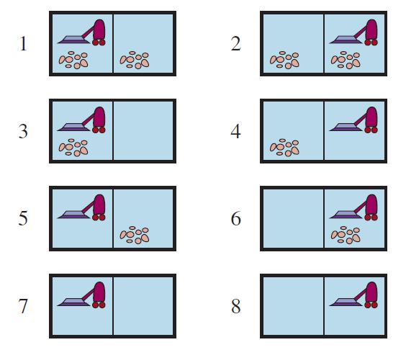

Example: Erratic Vacuum World
$Results\left(1, Suck\right)= \left\{5, 7\right\}$
Start State
Goal states
We need a conditional plan
[Suck, if State = 5 then [Right, Suck] else []]

Slide 8
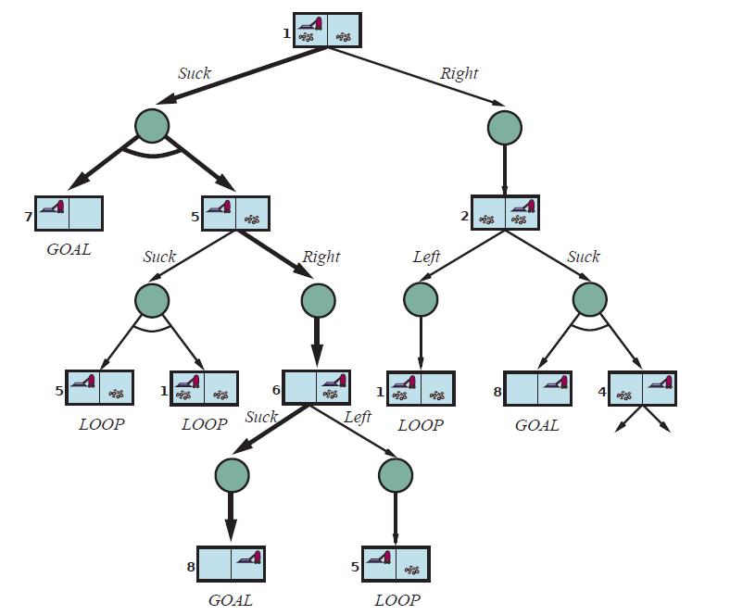
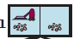

Finding a Cond. Plan: AND-OR Search Tree
Suck
OR node (choose action)
AND node (possible outcomes)
Right
Suck
Solution is shown with bold arrows:
[Suck, if State = 5 then [Right, Suck] else []]
Solution is a subtree that
has only GOAL leaf nodes
specifies one action at each OR node (state)
includes every outcome of AND nodes
LOOP: No need to continue search. Solution is the same as above.

Slide 9
AND-OR Tree search: Idea
Descend the tree by trying an action in each OR node and considering all resulting states of the AND nodes.
Remove branches (actions) if we cannot find a subtree below that leads to only goal nodes. (see failure in the code on the next slide).
Stop when we find a subtree that guarantees to only reach goal states.
Return the conditional plan that represents the subtree.
Suck
Right
LOOP: No need to continue search. Solution is the same as above.
Suck

Slide 10
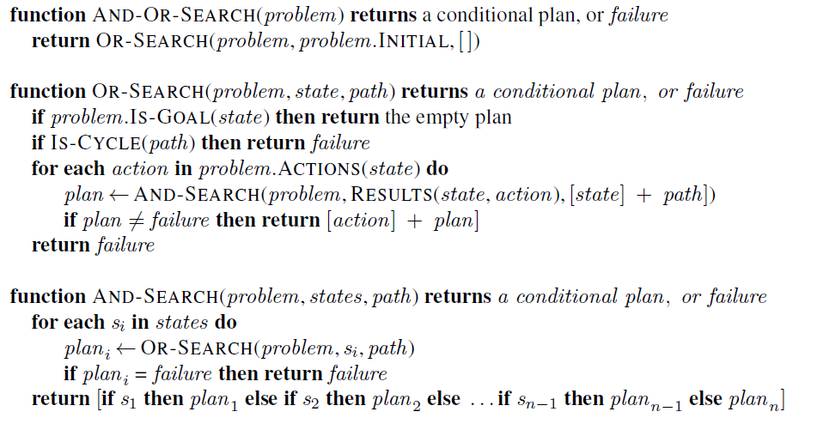
AND-OR Recursive DFS Algorithm
= nested If-then-else statements
path is only maintained for cycle checking!
// don’t follow loops using path.
// try all possible actions
// fail means we found no action that leads to // a goal-only subtree
// try all possible outcomes, none can fail! // (= belief state)
Notes:
The DFS search tree is implicitly created using the call stack (recursive algorithm).
DFS is not optimal! BFS and A* search can be used to find the optimal solution.

Slide 11
Use of Conditional Plans
The conditional plan can be used in a model-based reflex agent.
Example: After the initial action “suck”
Agent
Step
Program
1
[Suck,
if State = 5 then
[Right,
Suck]
else
[]
]
2
State
3
Step 2
4
4b

Slide 12

Search with no Observations
Using Actions to Coerce the World into Known States

Slide 13
No Observations
Sensorless problem = unobservable environment also called a conformant problem
Why is this useful?
Example: Doctor prescribes a broad-band antibiotic instead of performing time-consuming blood work for a more specific antibiotic. This saves time and money.
Basic idea: Find a solution (a sequence of actions) that works from any state and then just blindly execute it (open loop system).

Slide 14

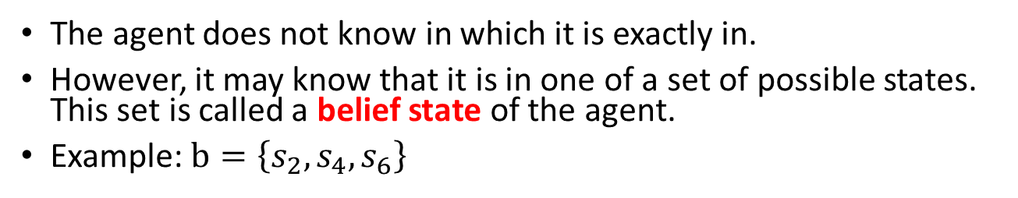

Belief State
The agent does not know in which it is exactly in.
However, it may know that it is in one of a set of possible states. This set is called a belief state of the agent.
Example: $b=\left\{s_{2},s_{4},s_{6}\right\}$
$$b$$

Slide 15
Actions to Coerce the World into States
Actions can reduce the number of possible states.
Example: Deterministic vacuum world. Agent does not know its position and the dirt distribution.
Initial belief state {1,2,3,4,5,6,7,8}
right
Goal states

Slide 16
Actions to Coerce the World into States
Actions can reduce the number of possible states.
Example: Deterministic vacuum world. Agent does not know its position and the dirt distribution.
suck

Slide 17
Actions to Coerce the World into States
The action sequence [right, suck, left, suck] coerces the world into the goal state 7. It works from any initial state!
There are no observations so there is no need for a conditional plan.
[right, suck, left, suck]

Slide 18
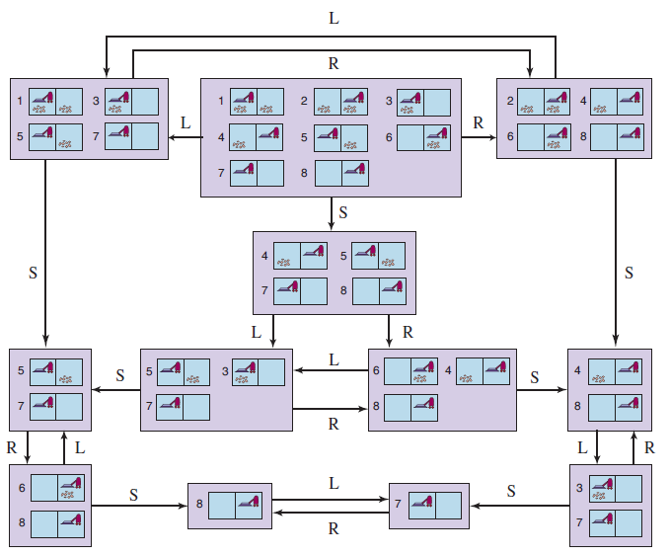
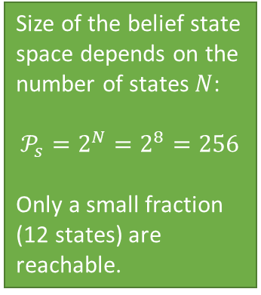
Example: The reachable belief-state space for the deterministic, sensorless vacuum world
Size of the belief state space depends on the number of states $N$:
$$𝒫_{s}=2^{N}=2^{8}=256$$
Only a small fraction (12 states) are reachable.
Initial belief state
One solution sequence:
[right, suck, left, suck]

Slide 19
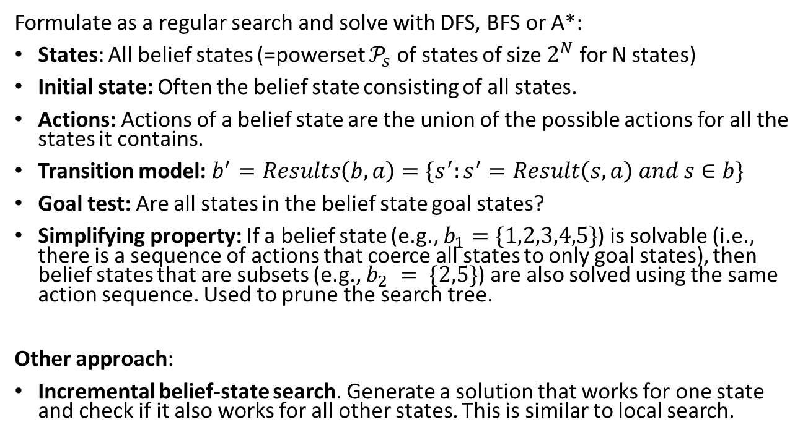
Finding a Solution Sequence
Note: State space size makes this impractical for larger problems!
Formulate as a regular search and solve with DFS, BFS or A*:
States: All belief states (=powerset $𝒫_{s}$ of states of size $2^{N}$ for N states)
Initial state: Often the belief state consisting of all states.
Actions: Actions of a belief state are the union of the possible actions for all the states it contains.
Transition model: $b^{′}=Results\left(b, a\right)=\{s^{′}:s^{′}=Result\left(s, a\right) and s∈b\}$
Goal test: Are all states in the belief state goal states?
Simplifying property: If a belief state (e.g., $b_{1}=\{1,2,3,4,5\}$) is solvable (i.e., there is a sequence of actions that coerce all states to only goal states), then belief states that are subsets (e.g., $b_{2} = \{2,5\}$) are also solved using the same action sequence. Used to prune the search tree.
Other approach:
Incremental belief-state search. Generate a solution that works for one state and check if it also works for all other states. This is similar to local search.

Slide 20

Partially Observable Environments
Using Observations to Learn About the State

Slide 21
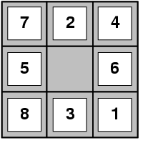
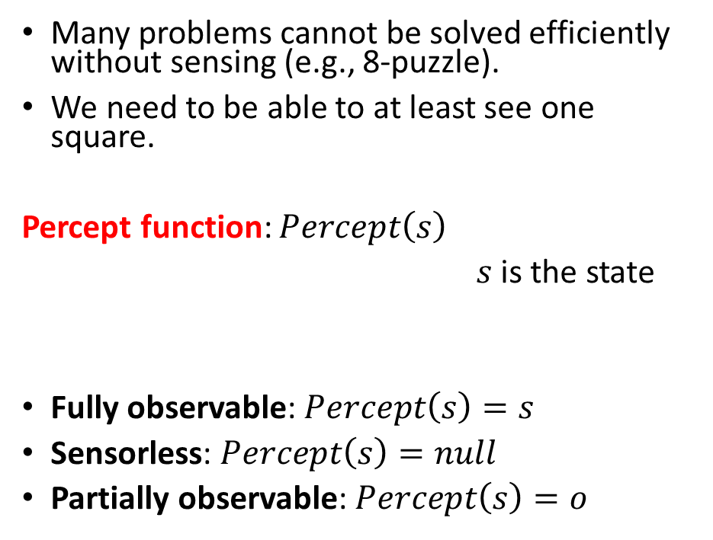
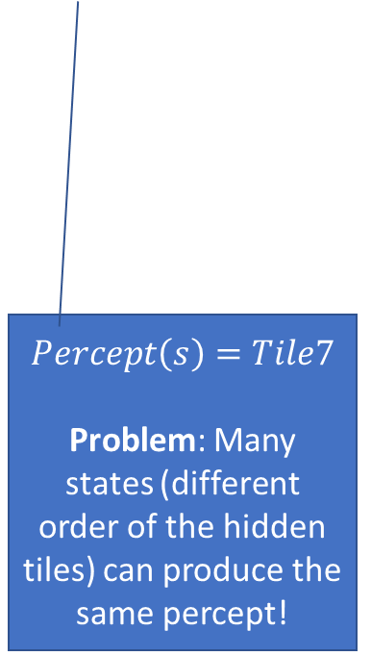
Percepts and Observability
Many problems cannot be solved efficiently without sensing (e.g., 8-puzzle).
We need to be able to at least see one square.
Percept function: $Percept\left(s\right)$
$s$ is the state
Fully observable: $Percept\left(s\right)=s$
Sensorless: $Percept\left(s\right)=null$
Partially observable: $Percept\left(s\right)=o$
$$Percept\left(s\right)=Tile7$$
Problem: Many states (different order of the hidden tiles) can produce the same percept!

Slide 22

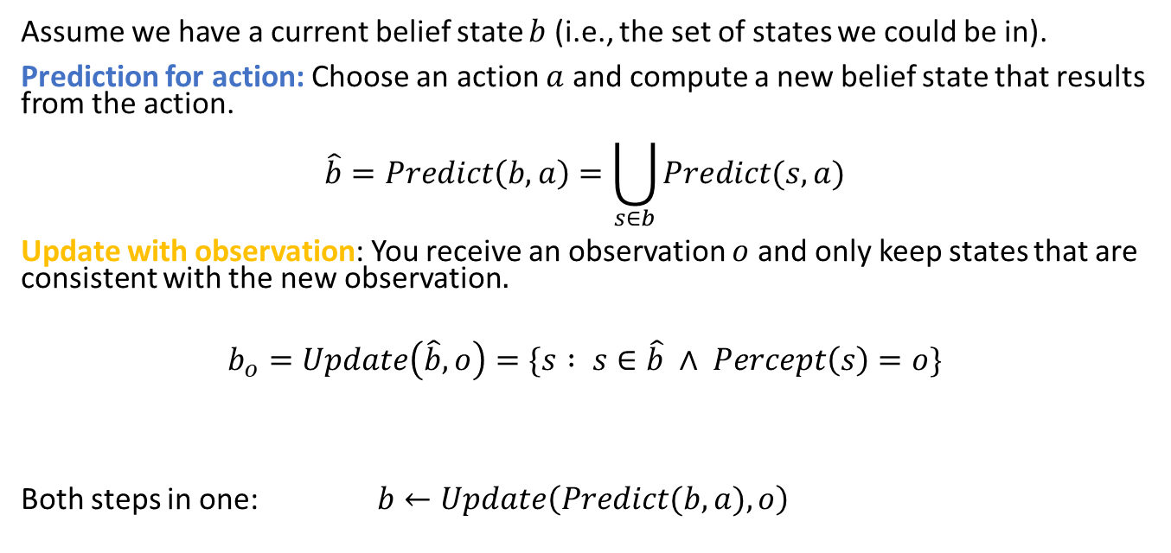
Use Observations to Learn About the State
Prediction for action
Update with observation
$$b$$
Agents choose an action and then receive an observation.
Idea: Observations can be used to learn about the agent’s state.
Assume we have a current belief state $b$ (i.e., the set of states we could be in).
Prediction for action: Choose an action $a$ and compute a new belief state that results from the action.
$$\hat{b}=Predict\left(b,a\right)=\bigcup_{s∈b}{Predict(s,a)}$$
Update with observation: You receive an observation $o$ and only keep states that are consistent with the new observation$.$
$$b_{o}=Update\left(\hat{b},o\right)=\{s : s∈\hat{b} ∧ Percept\left(s\right)=o\}$$
Both steps in one: $b←Update\left(Predict(b,a),o\right)$

Slide 23
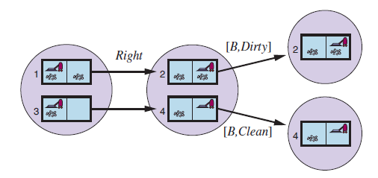


Example: Deterministic local sensing vacuum world
Prediction for action
Update with observation
$$b$$
Predict for actions
Update with observation
[R,Dirty]
$$b←Update\left(Predict\left( b , a \right), o \right)$$
$$Update\left(Predict\left(\left\{1,3\right\},Right\right),[R,Dirty]\right)=\{2\}$$

Slide 24
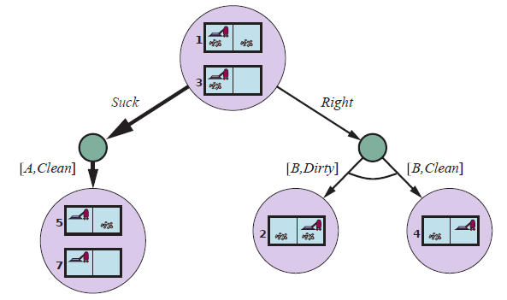
Solving Partially Observable Problems
Use an AND-OR tree of belief states to create a conditional plan
predict
OR
update
[L,Clean]
AND
[R,Dirty]
[R,Clean]
AND
Solution: [Suck, Right, if b = {6} then Suck else []]

Slide 25
Solving Partially Observable Problems
Use an AND-OR tree to create a conditional plan
predict
OR
update
[L,Clean]
AND
[R,Dirty]
[R,Clean]
AND
Solution: [Suck, Right, if b = {6} then Suck else []]

Slide 26
Solving Partially Observable Problems
Use an AND-OR tree to create a conditional plan
predict
OR
update
[L,Clean]
AND
[R,Dirty]
[R,Clean]
AND
…
Solution: [Suck, Right, if b = {6} then Suck else []]

Slide 27
Solving Partially Observable Problems
Use an AND-OR tree to create a conditional plan
predict
OR
update
[L,Clean]
AND
[R,Dirty]
[R,Clean]
AND
…
Solution: [Suck, Right, if b = {6} then Suck else []]

Slide 28
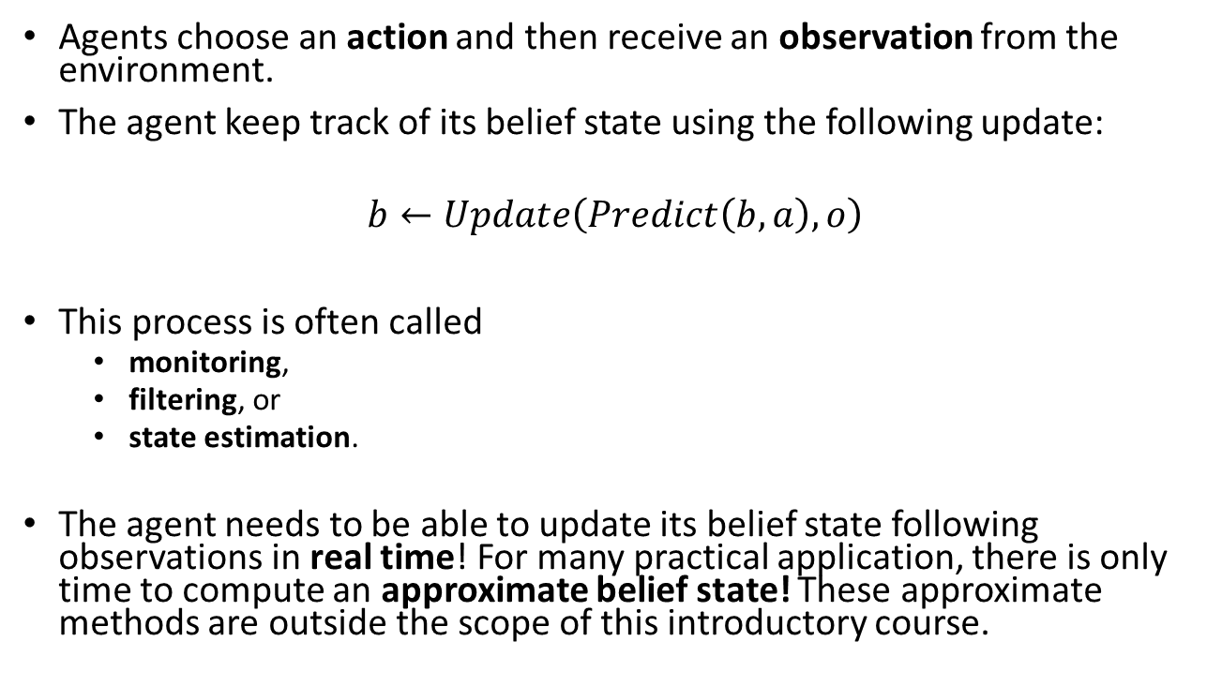
State Estimation and Approximate Belief States
Agents choose an action and then receive an observation from the environment.
The agent keep track of its belief state using the following update:
$$b←Update\left(Predict\left(b,a\right),o\right)$$
This process is often called
monitoring,
filtering, or
state estimation.
The agent needs to be able to update its belief state following observations in real time! For many practical application, there is only time to compute an approximate belief state! These approximate methods are outside the scope of this introductory course.

Slide 29
Case Study
Partially Observable 8-Puzzle

Slide 30
Partially Observable 8-Puzzle
How do we solve this problem? What are the main steps?
Give a problem description for each step.
States:
Initial state:
Actions:
Transition model:
Goal test:
Percept function:
What type of agent do we use?
What algorithms can be used?

Slide 31

Exploration
Unknown Environment and Online Search

Slide 32
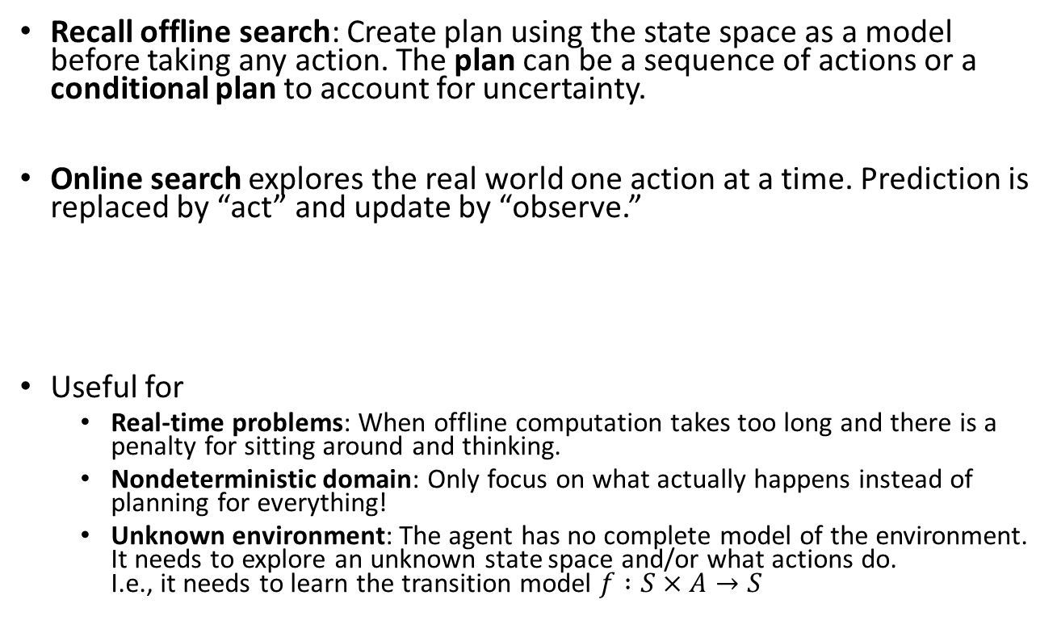
Online Search
Recall offline search: Create plan using the state space as a model before taking any action. The plan can be a sequence of actions or a conditional plan to account for uncertainty.
Online search explores the real world one action at a time. Prediction is replaced by “act” and update by “observe.”
Useful for
Real-time problems: When offline computation takes too long and there is a penalty for sitting around and thinking.
Nondeterministic domain: Only focus on what actually happens instead of planning for everything!
Unknown environment: The agent has no complete model of the environment. It needs to explore an unknown state space and/or what actions do. I.e., it needs to learn the transition model $f :S×A→S$
Act
Observe
Observe
Act
Act
…

Slide 33
Design Considerations for Online Search
Knowledge: What does the agent already know about the outcome of actions? E.g., does go north and then south lead to the same location?
Safely explorable state space/world: There are no irreversible actions (e.g., traps, cliffs). At least the agent needs to be able to avoid these actions.
Exploration order: Expanding nodes in local order is more efficient if you have to execute the actions to get observations: Depth-first search with backtracking instead of BFS or A* Search.

Slide 34
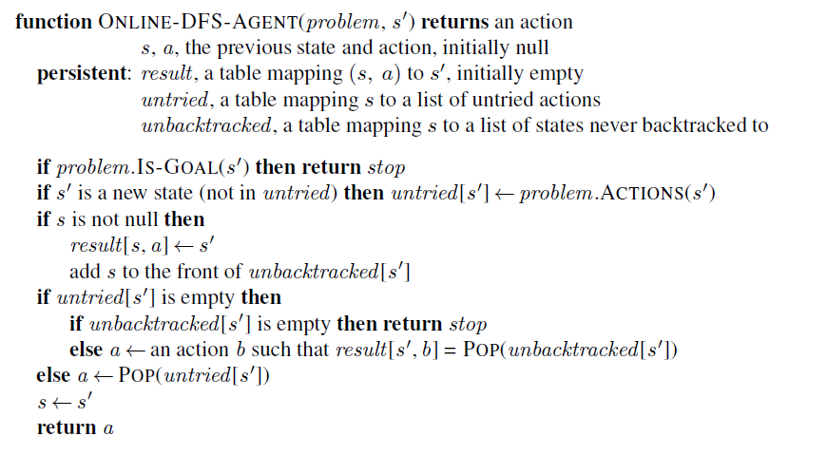
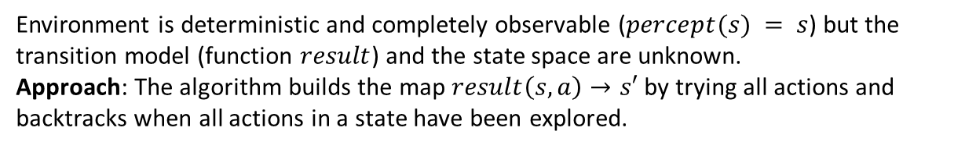
Online Search: Agent Program for Unknown Transition model
Environment is deterministic and completely observable ($percept(s) = s$) but the transition model (function $result$) and the state space are unknown.
Approach: The algorithm builds the map $result\left(s, a\right)→s′$ by trying all actions and backtracks when all actions in a state have been explored.
Learns results function
Untried and unbacktracked are the “frontier”
Record the found transition

Slide 35

Important concepts that you should be able to explain and use now…
Difference between solution types:
a fixed actions sequence, and
a conditional plan (also called a strategy or policy).
What are belief states?
How actions can be used to coerce the world into states.
How observations can be used to learn about the state: State estimation with repeated predict and update steps.
The use of AND-OR trees.

